Slide 1

Analysis of Northwind Consumer Purchasing Behavior for Northwind
James M. Irving, Ph.D.
Michael Moravetz
04/08/19

Slide 2
QUESTIONS ABOUT CONSUMER PURCHASING BEHAVIOR
Q1: “Do discounts have a statistically significant effect on the number of products customers order? If so, at what level(s) of discount?”
Q2: Do customers spend more money if they are buying discounted items?
Q3: Do customers buy different quantities depending on the time of year
Q4: Do countries spend more on average per order when they buy higher than average amounts of discounted items per order?

Slide 3
OUR METHODOLOGY
Explored SQL Database for data re: insights into consumer behavior.
Defined formal hypothesis and used the scientific method.
Performed analysis of data distributions to decide appropriate test.
D’Agostino & Pearson’s normality test.
Levene’s test for equal variance.
Performed proper statistical tests to test our hypotheses.
Mann-Whitney U
Tukey’s Pairwise Multiple Comparison tests.

Slide 4
HYPOTHESIS 1:
Do discounts have a statistically significant effect on the number of products customers order? If so, at what level(s) of discount?
𝐻1 : Products that are discounted sell in higher quantities.
𝐻0 : Products that are discounted sell the same quantities as full-price products.

Slide 5
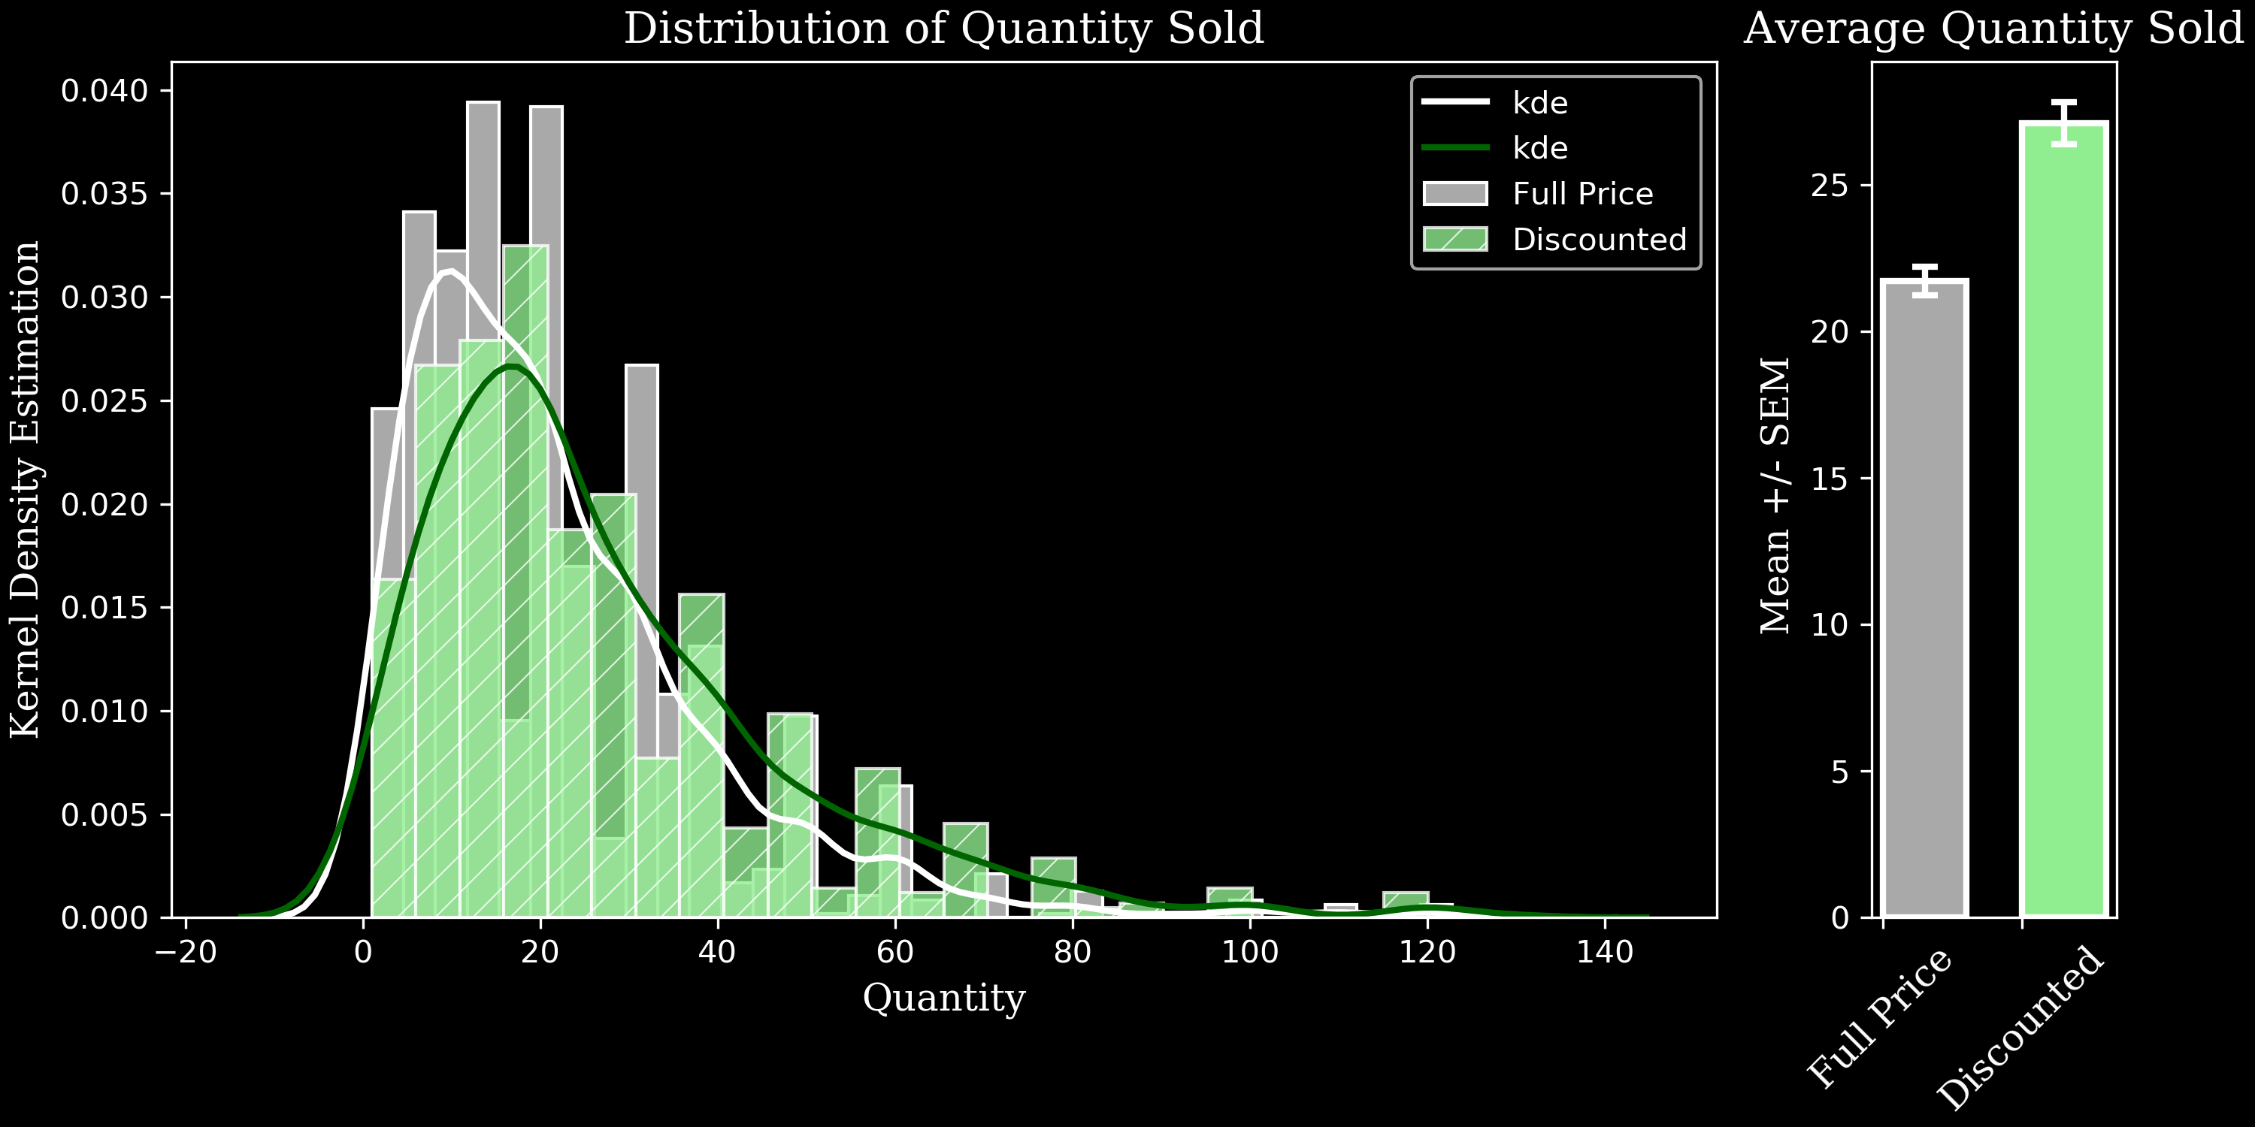
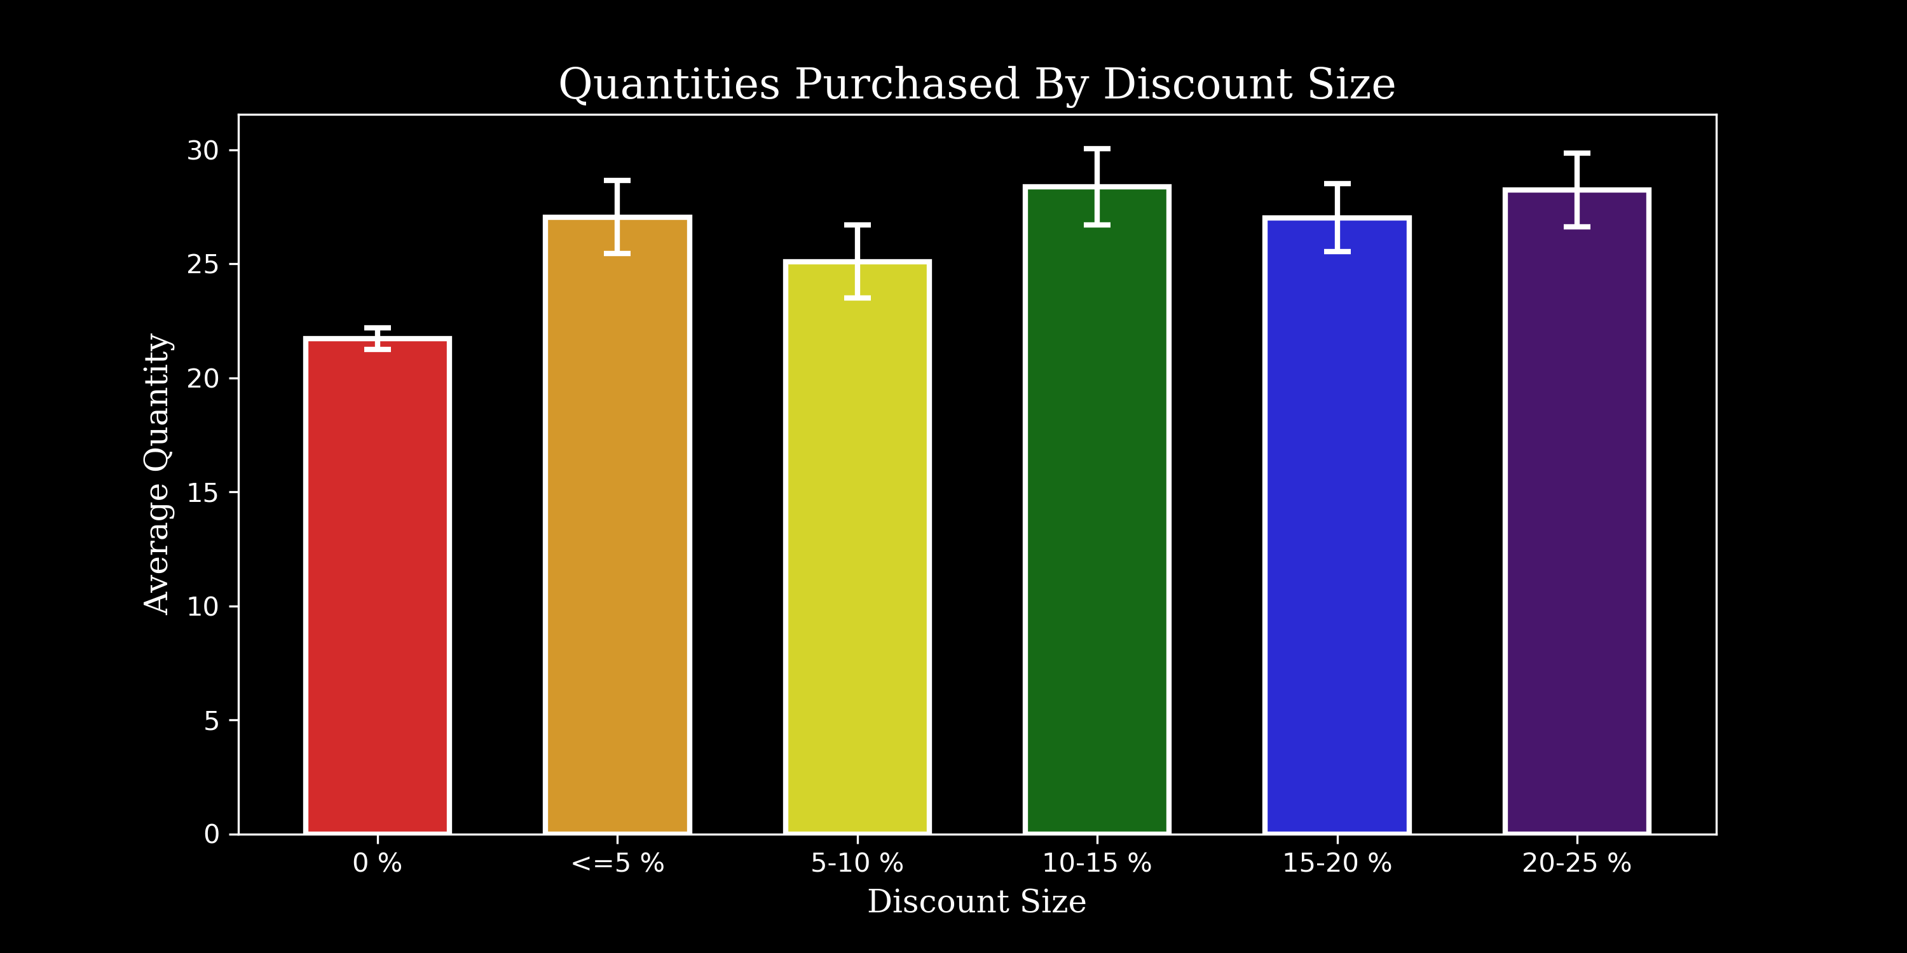
Results:

Slide 6
Hypothesis 2:
Do discounts have a statistically significant effect on the average price per order? If so, at what level(s) of discount?
𝐻1 : Customers spend more money overall when their order includes discounted items.
𝐻0 : Customers spend the same amount regardless of discounted items.

Slide 7
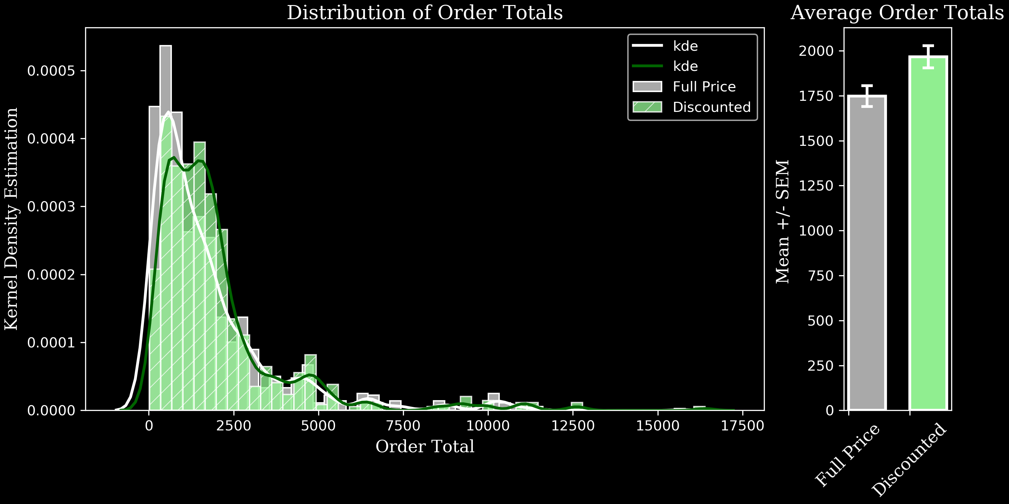
Results:

Slide 8
Hypothesis 3:
Do customers buy different quantities depending on the time of year?
H1 : The month an order is placed relates to either a higher or lower mean quantity of items sold.
H0 : The month an order is placed has no affect on the mean quantity of items sold.

Slide 9
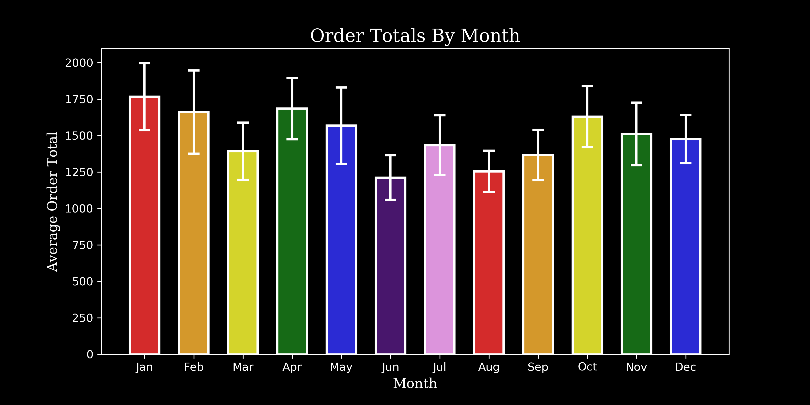

Slide 10
Hypothesis 4:
Do countries spend more on average per order when they buy higher than average amounts of discounted items per order?
H1: Orders shipped to countries where average orders contain higher than average amounts of discounted items per order spend more per order on average than other countries.
H0: Orders shipped to countries where average orders contain higher than average amounts of discounted items per order spend the same per order on average than other countries.

Slide 11
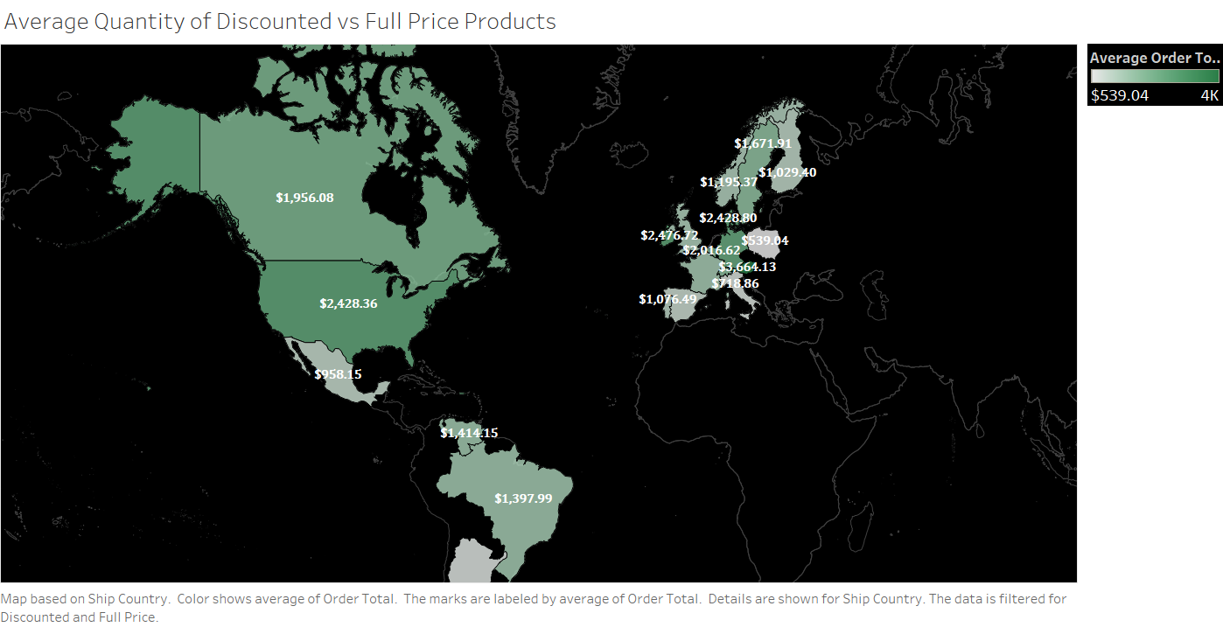

Slide 12


Slide 13
REQUIREMENTS.
Executive Summary Must-Haves
Contain between 5-10 professional quality slides detailing:
A high-level overview of your methodology
The results of your hypothesis tests
Any real-world recommendations you would like to make based on your findings (ask yourself--why should the executive team care about what you found?
How can your findings help the company?)
Take no more than 5 minutes to present
Avoid technical jargon and explain results in a clear, actionable way for non-technical audiences.

